Slide 1
Git

Slide 2
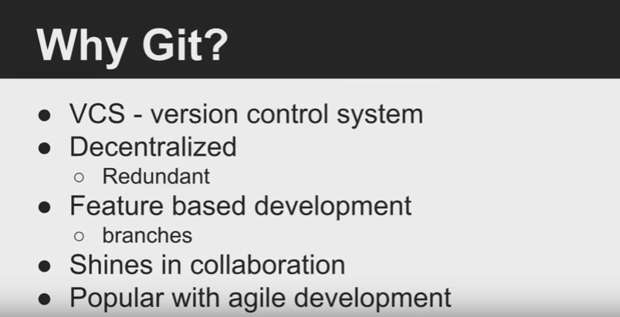

Slide 3
Exercises
Clone GitHub repo to Desktop
Modify README.md and Update remote repo
Add a file to remote repo
Uploading of repository
Add a README at GitHub repo
Pull it

Slide 4
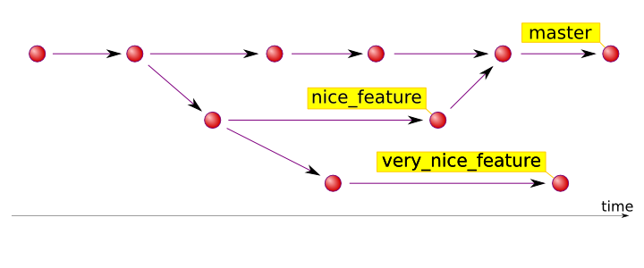
Branching, Merging, Conflicts

Slide 5
Branching, Merging, Conflicts
Create two GitHub accounts (use two different email address of yours)
Create a new repo on GitHub in your account # 1
Sign in account # 2 (incognito mode)
Assign a collaborator (account # 2) to this repo
For git commands:
https://www.youtube.com/watch?v=SWYqp7iY_Tc&ab_channel=TraversyMedia

